Slide 1
Plastic Pollution Is Becoming Recognized As A Major Problem For Our Environment and Living Organisms. Identify and Evaluate Two Methods of Addressing Plastic Pollution At Either National or Local Government Level.
Student’s Name
Institutional Affiliations

Slide 2
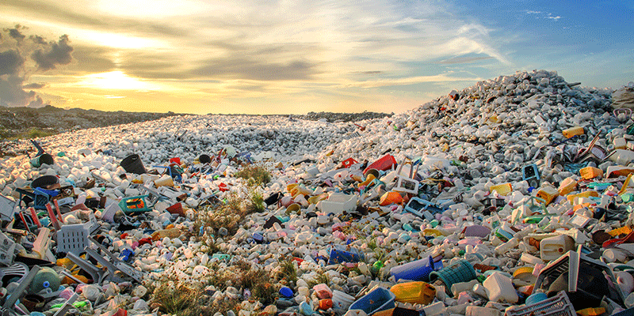
Introduction
The main objective of this presentation is to focus on how plastic pollution has become a problem in the environment and living organisms
The presentation will also concentrate on the two methods helpful in addressing plastic solution at the national government level
Notes:
The plastic solution issue has emerged to be a critical aspect in every part of the world. The whole world is worried about the condition and is trying to develop measures at the local and national levels to combat this pollution. The environment is suffering significantly so does the people because of the plastic toxic exposed in the world. Vital laws need to be taken fast to deal with the situation to save the world, especially the marine animals. This presentation will grasp the effects of water pollution and present two methods the national government has used to address plastic pollution.

Slide 3
Overview of Plastic Pollution
The global plastic industry was started with the production of the first synthetic plastic in 1907
Plastic materials are essential in reducing food waste and maintaining food quality
However, the management of plastic waste determines plastic pollution (Ritchie & Roser, 2018)
The environment and oceans have experienced significant impact due to plastic pollution
Notes:
Plastic pollution is where plastic materials and objects are released into the environment and cause adverse impacts on living organisms and humans on land and the ocean. Therefore, the global plastic industry's rise was initiated during the first synthetic plastic production in 1907, known as Bakelite. Although plastic waste is essential in keeping food quality due to its versatility and resistance, it also substantially affect the environment and living organisms. Nevertheless, this problem is based on managing the plastic material (Ritchie & Roser, 2018). Other means, such as renewable sources, are not taken seriously, ending up dropping them anywhere on land.

Slide 4
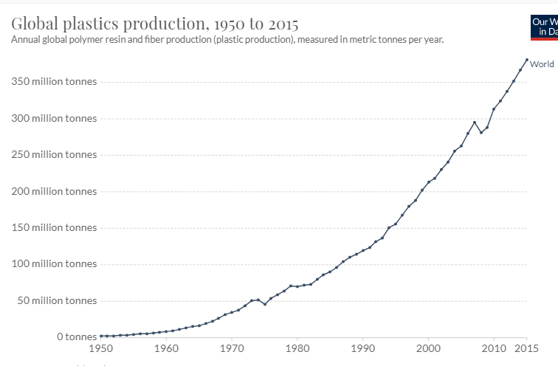
Facts and Information
The first production of plastic in 1907; mass production started in the 1950s
In 1950 plastic production was 2 million annually, but in 2015, it augmented to 381 million tonnes
Source: Geyer et al. (2017)
Notes:
Plastic production has increased substantially since the 1950s. Although the first plastic production was created in 1907, production was minor. However, according to Gourmelon (2015), by 1950, the annual plastic production was two million tonnes. Nevertheless, by 2015, plastic production intensified to three hundred and eighty-one million annually. This was nearly similar to the mass of two-thirds of the global population. Based on the graph below shows the data on plastic production from 1950 to 2015. The decrease in production between 2009 and 2010 is because of worldwide financial catastrophe in 2008, resulting in a reduction in production and consumerization of products.

Slide 5
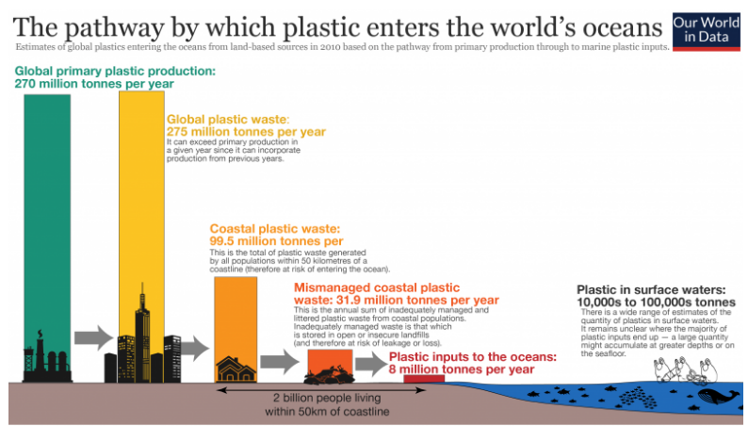
Facts and Information Cont…
Source: Jambeck et al. (2015)
Notes:
The first image indicates how plastic wastes get into the oceans. In 2010, the universal primary plastic manufacturing was two hundred and seventy million tonnes, and the worldwide plastic waste was two hundred and seventy-five million tonnes. Therefore, the plastic waste was more than the production. It contains other past years' materials; nevertheless, the wastes obtained in coastal areas are most likely to be in the water bodies such as oceans and comprises ninety-nine point five million tonnes. According to Jambeck et al. (2015), only plastic materials that are not adequately managed have the likelihood of polluting the environment and comprises 31.9 million tonnes in 2010. Nevertheless, an average of three percent of the overall plastic waste enters the ocean using other means such as rivers.

Slide 6
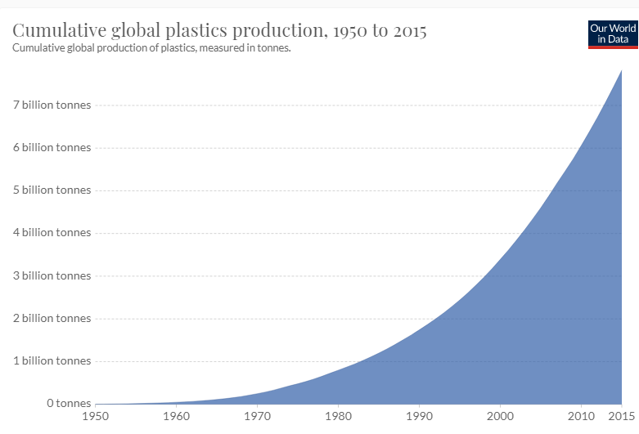
Why Is Plastic A Problem
More plastic is generated, and less is recycled
Plastic and its byproducts are spoiling the land and water bodies
Some plastic materials are considered toxic, especially the PVC
Others encompass Bisphenol-A which interferes with hormones
Source: Geyer et al. (2017)
Notes:
Plastic is considered a problem due to the effects seen o have caused. For instance, in the United States, more plastic is produced, and less is recycled; this results in many plastic materials and their byproducts filling in lands and water bodies such as oceans and rivers. The graph above indicates the amount of plastic recycled from 1980 to 2015 and how a large portion is discarded. Moreover, Leal Filho et al. (2019) claimed that some plastics are considered toxic, especially those containing vinyl. PVC comprises phthalates and other heavy metals hence developing dioxins when burning. Similarly, other plastics formed of Bisphenol-A, which is categorized as a chemical that alters hormones. Therefore, plastics are a problem because they pollute the environment, affect living organisms and cause health problems.

Slide 7
National Government Methods of Addressing Plastic Pollution
Decrease plastic production and usage
Policy reforms and legislations
Notes:
The national government plays a critical role in stopping plastic pollution. The government has a role in safeguarding their people and protecting the environment; this entails that they are responsible for ensuring the citizens live in a better environment. Therefore, the national government can address plastic pollution by decreasing plastic production and utilization in the country and developing policy reforms and legislation towards plastics production and usage. Although other methods can be used, these two are significant in handling the plastic solution issue as they will involve both the people, plastic industries, and the local government.

Slide 8
Decrease Plastic Production and Usage
Encourage water refill stations (Filatov et al., 2018)
Create awareness to the public
Recognize individuals that cut plastic water in their practices
Involve companies in solving the problem
Notes:
The national government can reduce plastic production by ensuring that the public utilizes one bottle in their day-to-day schedules. In most cases, people purchase water in plastic bottles; however, people can use one bottle to satisfy their consumption (Filatov et al., 2018). Also, the government can create awareness to educate people on the importance of not using plastics and ensure they understand the effects it has on their health and the environment. Recognizing individuals who do not use plastic in their practices, such as restaurants, encourages people to use reusable containers and rewards them. This will help reduce plastic usage, producing and making the business a leader in promoting plastic-free materials. Plastic industries and other companies using plastic materials can develop products that can easily be recycled and develop plastic pollution solutions.

Slide 9
Policy Reforms and Legislation Enforcement
Implementation of plastic bans laws
Extended producer responsibility laws (Xanthos & Walker, 2017)
Container deposit laws
Commissions and councils
Notes:
The national government can use various policy reforms and legislation to reduce plastic pollution. First is implementing ban policies, where the legislation will reduce the use of single-use plastic bags. The government can also use extended producer responsibility laws, which require the manufacturers to be accountable for their plastic waste management. This law is developed to reduce plastic pollution by giving manufacturers the responsibility to recycle their plastics and create recycling programs (Xanthos & Walker, 2017). Also, container deposit laws are essential in reducing plastic pollution. They will require distributors to take deposits until the plastic bottle is returned to the client and be given their deposits. Finally, through commission and councils, the government can realize the severity and effects of plastic pollution and act on the recommendations presented.

Slide 10
Bans Regulations
Comprehensive single-use plastic bans (da Costa et al., 2020)
Plastic bag bans or imposes a fee
Straws
Polystyrene
Notes:
The national government can control bans regulations based on the type of products that significantly affect the environment. For instance, the national government can utilize comprehensive single-use plastic bans and require the country not to use any single-use and nonrecyclable product (da Costa et al., 2020). This will include the supply of any single-use plastic product, including carryout bags. Also, the government uses plastic bag bans or charges fees to those than produce the products. This will also reduce the usage due to the effect of fees. Straws comprise many single-use plastics; therefore, the government can put restrictions and require its users to be based on customer request and finally barring polystyrene.

Slide 11
Conclusion
Plastic pollution is the release of plastic material into the environment, and they cause adverse effects to the living organisms
The first plastic was produced in 1907, but mass production started in 1950
The national government can use policy reforms and decrease in plastic production to address the plastic pollution problem
Policy reforms and legislations include plastic bags, container deposit laws and commission and councils
Reduce plastic production and usage will include creating awareness, encourage water refill stations and recognize individuals that have eliminated plastic use in their practices
Notes:
Plastic pollution has emerged as one of the most controversial topics because of the adverse effects on land and aquatic life. Plastic pollution is defined as the release of product materials and objects into the environment, and they cause significant effects on living organisms. Although plastics are considered cheap, resistant and versatile, they have a substantial impact on the world. The first plastic was developed in 1907; however, it was until the 1950s when mass production started, and by 2015 production of plastic bags was immense and recycling less. The national government can handle plastic solutions using two methods, including reducing plastic production and usage and policy reforms. The plastic reduction can be made by creating awareness to the public, rewarding individuals with reduced plastic use in their practice and policy reforms, and legislation enforcement can be used by plastic bans, container deposit, and extended producer responsibility laws.

Slide 12
References
da Costa, J. P., Mouneyrac, C., Costa, M., Duarte, A. C., & Rocha-Santos, T. (2020). The role of legislation, regulatory initiatives and guidelines on the control of plastic pollution. Frontiers in Environmental Science.
Filatov, V. V., Zaitseva, N. A., Larionova, A. A., Zhenzhebir, V. N., Polozhentseva, I. V., Takhumova, O. V., & Kolosova, G. M. (2018). State Management of Plastic Production Based on the Implementation of UN Decisions on Environmental Protction. Ekoloji Dergisi, (106).
Geyer, R., Jambeck, J. R., & Law, K. L. (2017). Production, use, and fate of all plastics ever made. Science advances, 3(7), e1700782.
Gourmelon, G. (2015). Global plastic production rises, recycling lags. Vital Signs, 22, 91-95.
Jambeck, J. R., Geyer, R., Wilcox, C., Siegler, T. R., Perryman, M., Andrady, A., ... & Law, K. L. (2015). Plastic waste inputs from land into the ocean. Science, 347(6223), 768-771.
Leal Filho, W., Saari, U., Fedoruk, M., Iital, A., Moora, H., Klöga, M., & Voronova, V. (2019). An overview of the problems posed by plastic products and the role of extended producer responsibility in Europe. Journal of cleaner production, 214, 550-558.
Ritchie, H., & Roser, M. (2018). Plastic pollution. Our World in Data.
Xanthos, D., & Walker, T. R. (2017). International policies to reduce plastic marine pollution from single-use plastics (plastic bags and microbeads): a review. Marine pollution bulletin, 118(1-2), 17-26.

